Slide 1
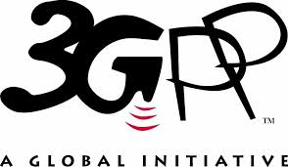
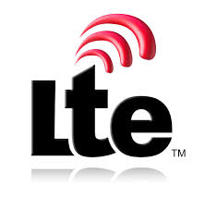
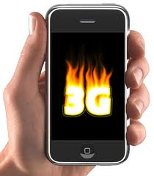
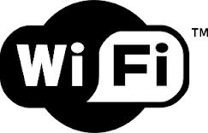

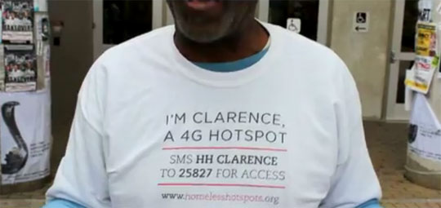
Mobile networks
This lecture covers cellular data technologies
It does not cover:
Notes:
A mobile phone network or cellular phone network as it is also known, is made up of a large number of signal areas called cells. These cells join or overlap each other to form a large coverage area. ... Communication over the mobile network can be made up of voice, data, images and text messages.
Wi-Fi is simply a trademarked term meaning IEEE 802.11x. The false notion that the brand name "Wi-Fi" is short for "wireless fidelity" has spread to such an extent that even industry leaders have included the phrase wireless fidelity in a press release.

Slide 2
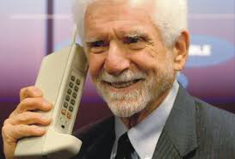

History of Mobile Data Networks
Remember that phones were originally designed for calls
Notes:
The first network became commercially available in 1983 in the United States, with Japan utilizing the same technology in 1987. The first 2G networks incorporated digital signals into cellular networks. ... Companies developed 3G networks in the early to mid-2000s with standardization and data streaming in mind.

Slide 3
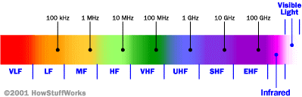
Cellular Network Basics
There are many types of cellular services;
Cellular network/telephony is a radio-based technology; radio waves are electromagnetic waves that antennas propagate
Most signals are in the 850 MHz, 900 MHz, 1800 MHz, and 1900 MHz frequency bands
Cell phones operate in this frequency range (note the logarithmic scale)
Notes:
Cellular data uses the same network provided by the cell towers that allow you to make phone calls. WiFi has a limited range, whereas cellular data is available as long as you are within your carrier's coverage.
Cellular Network Types
GSM Cellular Network.
GPRS Cellular Network.
CDMA Cellular Network.
MOBITEX Cellular Network.
EDGE Cellular Network.
GSM (Global System for Mobile communication) is a digital mobile network that is widely used by mobile phone users in Europe and other parts of the world.
The Global System for Mobile Communications (GSM) is a standard developed by the European Telecommunications Standards Institute (ETSI) to describe the protocols for second-generation (2G) digital cellular networks used by mobile devices such as mobile phones and tablets. Radio Spectrum are:
VLF – Very Low Frequency; LF – Low Freq; MF – Medium Freq; HF – High Freq; VHF – Very High; UHF – Ultra High; SHF – Super High; EHF – Extra High

Slide 4
Cellular Network Generations
It is useful to think of cellular Network/telephony in terms of generations:
0G: Briefcase-size mobile radio telephones
1G: Analog cellular telephony
2G: Digital cellular telephony
3G: High-speed digital cellular telephony (including video telephony)
LTE (4G): IP-based “anytime, anywhere” voice, data, and multimedia telephony at faster data rates than 3G
Notes:
The evolution of cellular communications networks is commonly known by 1G, 2G, 3G and 4G designations.
The first generation (1G) mobile wireless communication network was analog used for voice calls only. The second generation (2G) is a digital technology and supports text messaging. The third generation (3G) mobile technology provided higher data transmission rate, increased capacity and provide multimedia support. Long-Term Evolution (LTE) is a standard for wireless broadband ... The LTE wireless interface is incompatible with 2G and 3G networks, so that it must be operated on a separate radio spectrum. Its designed to provide up to 10x the speeds of 3G networks for mobile devices such as smartphones, tablets, netbooks, notebooks and wireless hotspots.

Slide 5
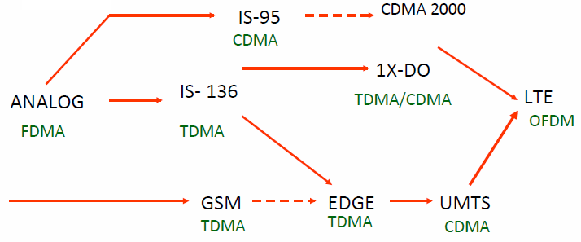
Evolution of Cellular Networks
1G
2G
2.5G
3G
4G
Notes:
The method chosen by GSM is a combination of Time- and Frequency-Division Multiple Access (TDMA/FDMA). FDMA is a method that lets more than one user to share a single radio frequency spectrum. Time-division multiple access (TDMA) is a channel access method for shared-medium networks. It allows several users to share the same frequency channel by dividing the signal into different time slots. CDMA (Code-Division Multiple Access) refers to any of several protocols used in second-generation (2G) and third-generation (3G) wireless communications. As the term implies, CDMA is a form of multiplexing, which allows numerous signals to occupy a single transmission channel, optimizing the use of available bandwidth. OFDM (Orthogonal Frequency Division Multiplexing) is a method of encoding digital data on multiple carrier frequencies; technique in transmitting large amount of digital data over a radio wave. The technology works by splitting the radio signal into multiple smaller sub-signals that are then transmitted simultaneously at different frequencies to the receiver.

Slide 6
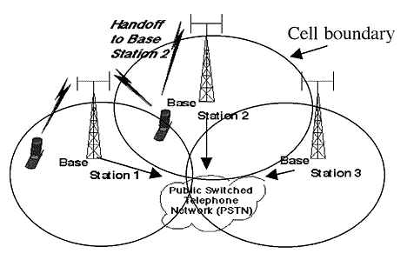
Cellular Network
Base stations transmit to and receive from mobiles at the assigned spectrum
Multiple base stations use the same spectrum (spectral reuse)
The service area of each base station is called a cell
Each mobile terminal is typically served by the ‘closest’ base stations
Handoff when terminals move
Notes:
A handoff refers to the process of transferring an active call or data session from one cell in a cellular network to another or from one channel in a cell to another. A well-implemented handoff is important for delivering uninterrupted service to a caller or data session user.

Slide 7
The Multiple Access Problem
The base stations need to serve many mobile terminals at the same time (both downlink and uplink)
All mobiles in the cell need to transmit to the base station
Interference among different senders and receivers
So we need multiple access scheme
Notes:
Multiple access is a technique that lets multiple mobile users share the allotted spectrum in the most effective manner. ... In computer networks and telecommunications, the multiple access method permits various terminals to connect to the same multi-point transmission medium to transmit over it and share its capacity.

Slide 8
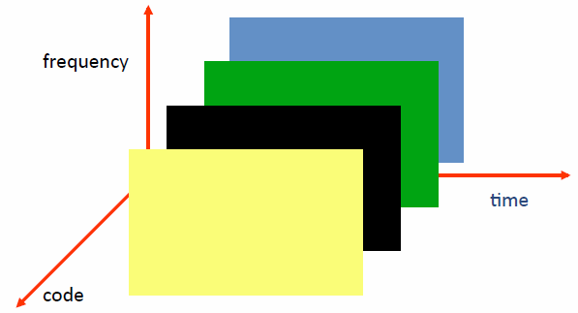
Multiple Access Schemes
3 orthogonal Schemes:
Frequency Division Multiple Access (FDMA)
Time Division Multiple Access (TDMA)
Code Division Multiple Access (CDMA)
Notes:
Multiple access is a technique that lets multiple mobile users share the allotted spectrum in the most effective manner. ... In computer networks and telecommunications, the multiple access method permits various terminals to connect to the same multi-point transmission medium to transmit over it and share its capacity.

Slide 9
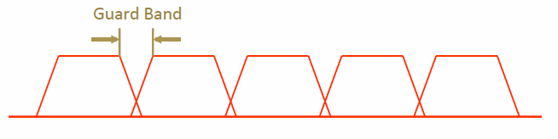
Frequency Division Multiple Access
frequency
Each mobile is assigned a separate frequency channel for a call
Guard band is required to prevent adjacent channel interference
Usually, one downlink band and one uplink band
Different cellular network protocols use different frequencies
Frequency is precious and scarce – we are running out of it
Cognitive radio
Notes:
Guard band is an unused part of the radio spectrum btw radio bands, for the purpose of preventing interference. Ensures both can transmit simultaneously without interfering with each other.
A cognitive Radio is a radio that can be programmed and configured dynamically to use the best wireless channels in its vicinity to avoid user interference and congestion.

Slide 10
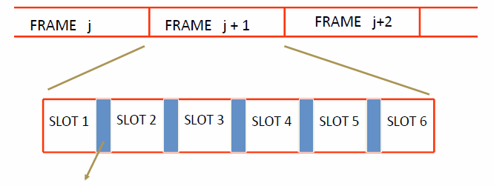
Time Division Multiple Access
Guard time – signal transmitted by mobile terminals at different locations do no arrive at the base station at the same time
Time is divided into slots and only one mobile terminal transmits during each slot
Like during the lecture, only one can talk, but others may take the floor in turn
Each user is given a specific slot. No competition in cellular network
Unlike Carrier Sensing Multiple Access (CSMA) in WiFi
Notes:
Carrier Sense Multiple Access (CSMA) is a network protocol that listens to or senses network signals on the carrier/medium before transmitting any data. CSMA is implemented in Ethernet networks with more than one computer or network device attached to it. CSMA is part of the Media Access Control (MAC) protocol.

Slide 11
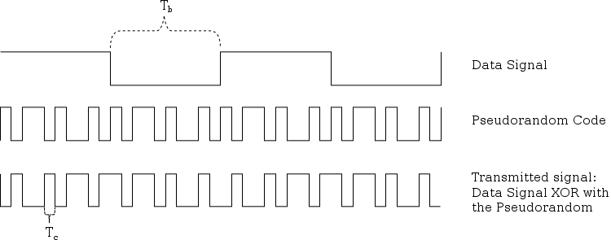
Code Division Multiple Access
Use of orthogonal codes to separate different transmissions
Each symbol of bit is transmitted as a larger number of bits using the user specific code – Spreading
Bandwidth occupied by the signal is much larger than the information transmission rate
But all users use the same frequency band together
Orthogonal among users
Notes:
Orthogonal codes: Two codes are said to be orthogonal if when they are multiplied together the result is added over a period of time they sum to zero. For example a codes 1 -1 -1 1 and 1 -1 1 -1 when multiplied together give 1 1 -1 -1 which gives the sum zero.

Slide 12
Why am I telling you this?
…and cell networks (pre-LTE) were not designed for IP
Instead, optimized for
Circuit-switched
Low bitrate (calls/text)
Charging customers, allowing connections from any cell provider
The performance we get out of cell networks is intimately tied to network design

Slide 13
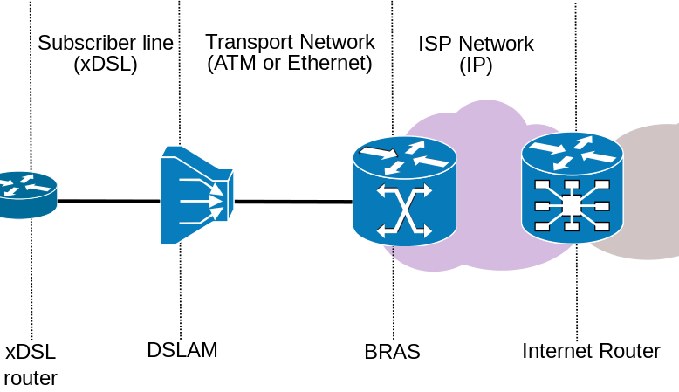
Wired networks are relatively simple
DSL Access Multiplexer:
Separates voice and data
Broadband Remote Access Server:
Bridge between layer 2 and 3, sits in core
Notes:
xDSL. Refers collectively to all types of digital subscriber lines, the two main categories being ADSL and SDSL. Two other types of xDSL technologies are High-data-rate DSL (HDSL) and Very high DSL (VDSL). DSL technologies use sophisticated modulation schemes to pack data onto copper wires.
xDSL refers to the sum total of digital subscriber line (DSL) technologies.
A DSLAM, or Digital-Subscriber-Line-Access-Multiplexer, is a network distribution device that aggregates individual subscriber lines into a high-capacity uplink. These high capacity uplinks, either ATM or Gigabit Ethernet, connect subscribers to their Internet service providers (ISPs).
BRAS. Short for Broadband Remote Access Server, it is the aggregation point for the subscriber traffic. It provides aggregation capabilities (e.g. IP, PPP, ATM) between the Regional/Access Network and the NSP or ASP.
Unlike a standard router that accesses the Internet through a cable, a cellular router enables you to get Internet access through a cellular data network. Depending on your Internet needs, a cellular router used in combination with a cellular adapter could be your most advantageous option.

Slide 14
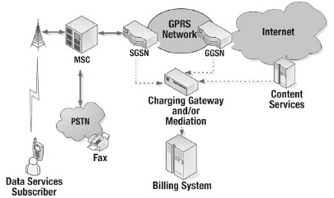
“Simplified” view of 3G
Mobile switching center:
Analog to digital
NodeB & Base Station Controller:
Converts RF to wired
Serving GPRS Support Node:
Move IP packets to/from radio network
Gateway GPRS Support Node:
Route to/from the Interet
$
Notes:
The Node B provides the connection between mobile phones (UEs) and the wider telephone network. UMTS is the dominating 3G standard.
A mobile switching center (MSC) is the centerpiece of a network switching subsystem (NSS). The MSC is mostly associated with communications switching functions, such as call set-up, release, and routing. ... The MSC is structured so that base stations connect to it, while it connects to the PSTN.
SGSN. The Serving GPRS Support Node (SGSN) is a main component of the GPRS network, which handles all packet switched data within the network, e.g. the mobility management and authentication of the users. ... The SGSN is the service access point to the GPRS network for the mobile user.
GGSN. The Gateway GPRS Support Node (GGSN) is a main component of the GPRS network. The GGSN is responsible for the interworking between the GPRS network and external packet switched networks
The PSTN consists of telephone lines, fiber optic cables, microwave transmission links, cellular networks, communications satellites, and undersea telephone cables, all interconnected by switching centers, thus allowing most telephones to communicate with each other.

Slide 15
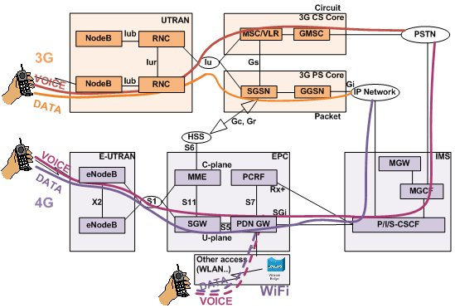
Packet switched vs circuit switched
3G and earlier maintains two data paths
Circuit switched: Phone calls (8kbps) and SMS/MMS
Packet switched: All IP data
Notes:
Circuit switching and packet switching are the two switching methods that are used to connect the multiple communicating devices with one another. ... The main difference between circuit switching and packet switching is that Circuit Switching is connection oriented whereas, Packet Switching is connectionless.

Slide 16
Packet switched vs circuit switched
LTE uses “all in one” approach
Everything over IP, including voice
S-GW (Serving Gateway) replaced SGSN, P-GW replaces GGSN
Notes:
The Node B provides the connection between mobile phones (UEs) and the wider telephone network. UMTS is the dominating 3G standard.
eNodeB. E-UTRAN Node B, also known as Evolved Node B (abbreviated as eNodeB or eNB), is the element in E-UTRA of LTE that is the evolution of the element Node B in UTRA of UMTS. ... Traditionally, a Node B has minimum functionality, and is controlled by a Radio Network Controller (RNC).
Serving Gateway (SGW) is a critical network function for the 4G mobile core network, known as the evolved packet core (EPC). The SGW resides in the user plane where it forwards and routes packets to and from the eNodeB and packet data network gateway (PGW).

Slide 17
Backward compatibility
Notes:
Backward compatible (or sometimes backward-compatible or backwards compatible) refers to a hardware or software system that can successfully use interfaces and data from earlier versions of the system or with other systems.

Slide 18
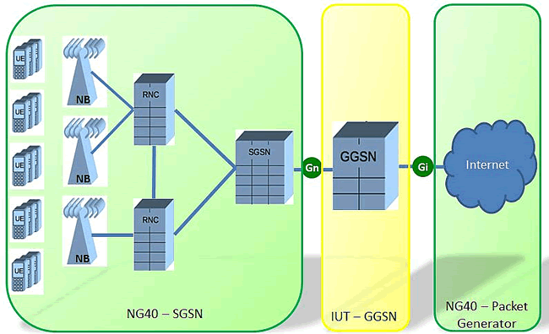
Mobile Architecture in practice
RNC/NodeB: 1000s
SGSNs/S-GWs: 10s or 100s
GGSN/P-GWs: < 10
Why is this a problem?
Notes:
A radio network controller (RNC) is a governing element in the UMTS radio access network (UTRAN) and is responsible for controlling the Node Bs that are connected to it. The RNC carries out radio resource management, some mobility management functions and encrypts data before it is sent to and from the mobile.

Slide 19
Wireless/Radio Issues
Conflicting goals
IP application assume “always on” connectivity
Radio consumes large amounts of power
How to balance the two?
Compromise in UMTS networks: 3 power states
Idle: No data channel, only paging, almost no power
FACH: Shared, low-speed channel, low power
DCH: Dedicated channel, high speed, high power
Notes:
The Universal Mobile Telecommunications System (UMTS) is a third generation mobile cellular system for networks based on the GSM standard. ... UMTS uses wideband code division multiple access (W-CDMA) radio access technology to offer greater spectral efficiency and bandwidth to mobile network operators.
Forward Access Channel (FACH) (down link). This is channel carries data or information to the UEs that are registered on the system. There may be more than one FACH per cell as they may carry packet data. Paging Channel (PCH) (downlink).
Dedicated Control Channel (DCCH): A point-to-point bi-directional channel that transmits dedicated control information between a UE and the network. It is used by UEs that have already established RRC connection. The traffic channels are exclusively used for the transfer of user-plane information.

Slide 20
Issues with this approach
State promotions have promotion delay
State demotions incur tail times
800 mW
High Bandwidth
DCH
Send/Recv any data
Idle for 5 s
Queue > threshold
IDLE
FACH
Idle for 12 s
460 mW
Low Bandwidth
No Power
No BW

Slide 21
Delays add up…
Delay to send a packet
Delay to save power

Slide 22
… to inefficiency
Inefficient radio utilization (34% power/channel)
Notes:
UL/DL ratio. UL/DL ratio. (Upload/Download ratio, Upstream/Downstream ratio, Uplink/Downlink ratio) The difference in speed between transmitting and receiving. For Internet access, the upload speed from the user is typically considerably lower than the download speed to the user.

Slide 23
LTE Key Features
Uses Multi-input Multi-output (MIMO) for enhanced throughput
Reduced power consumption
Higher RF power amplifier efficiency (less battery power used by handsets)
Lower latency to get access to the medium
Performance sometimes better than WiFi!

Slide 24
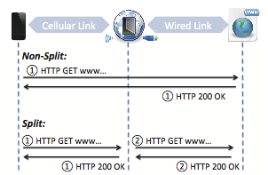
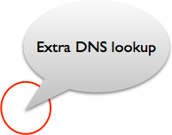
Middleboxes in Mobile Networks
Carrier-grade NAT
Devices often assigned private IPs
Firewalled connections
Content optimizers
Split TCP connections
Why?
Compression and caching
Other strange behavior
How might we measure
these?
Mobile networks
Mobile networks
Notes:
Cellular carriers usually deploy various types of middleboxes to make efficient use of these precious resources and protect them from potential attacks. For instance, many carri- ers use NAT (Network Address Translation) to provide data service to millions of users over a limited public IP address space.

